Slide 1
What is DOM

Slide 2
Define DOM tree

Slide 3
Define Styling in HTML Vs DOM

Slide 4
Sequence wise count and perform the5 ways to target DOM

Slide 5
Why first 2 are different

Slide 6
Difference between innerText, innerHTML, textContent

Slide 7
getAttribute VS Attributes Note: To get Attribute we use getAttribute and Attribute

Slide 8
setAttribute() first enter style + style value secondly enter class + class name removeAttribute()

Slide 9
Define classList and its methods

Slide 10
Define Traversing and it’s 6 types in sequence so that it is possible for you to understand and rememberable

Slide 11
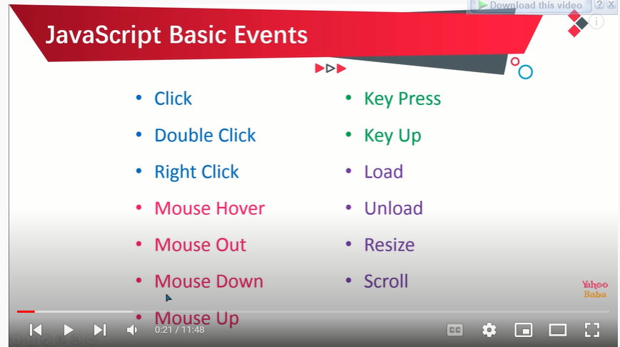

Slide 12
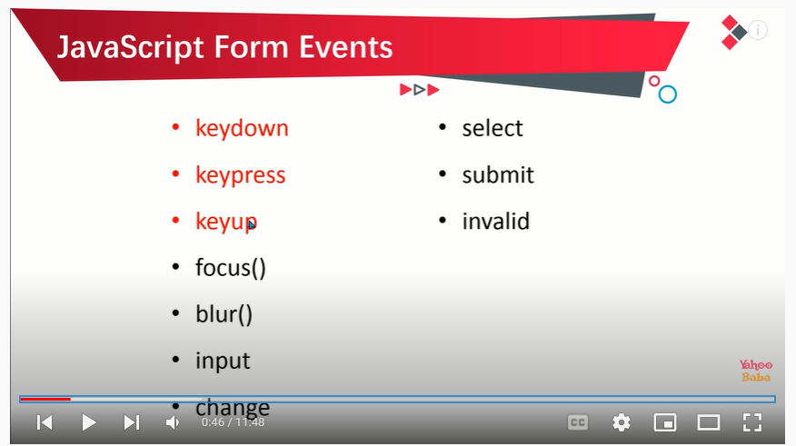

Slide 13
Define Event propagation, Event delegation

